Slide 1
Free Datasets for All OpenData.go.ke
Workshop on Data Science in Africa 2015
19th June 2015
Dedan Kimathi University of Technology
Prestone Adie
Data Analytics

Slide 2
What do you want to do?
Create an app

Slide 3
What do you want to do?
Create an app

Slide 4
What do you want to do?
Create an app

Slide 5
What do you want to do?
Create an app

Slide 6
What else do you want to do?
Create an app
Write a paper

Slide 7
What else do you want to do?
Create an app
Write a paper

Slide 8
What else do you want to do?
Create an app
Write a paper

Slide 9
Is that All?
Create an app
Write a paper
Give a lecture

Slide 10
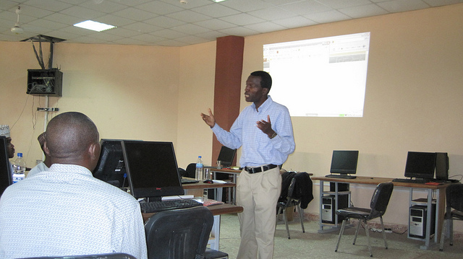
Is that All?
Create an app
Write a paper
Give a lecture

Slide 11
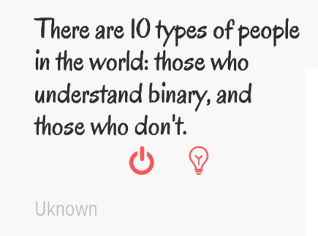
Ok. That should be all, no?
Create an app
Write a paper
Give a lecture
Make a statement/argument

Slide 12
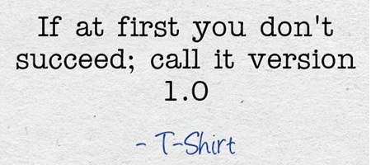
Ok. That should be all, no?
Create an app
Write a paper
Give a lecture
Make a statement/argument

Slide 13
Ok. That should be all, no?
Create an app
Write a paper
Give a lecture
Make a statement/argument

Slide 14
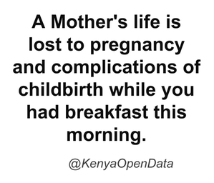
Ok. That should be all, no?
Create an app
Write a paper
Give a lecture
Make a statement/argument
Test a theory

Slide 15
What do you need to do this?
Knowledge in the field of focus

Slide 16
What do you need to do this?
Knowledge in the field of focus
Data

Slide 17
What do you need to do this?
Knowledge in the field of focus
Data
Tools for analysis and visualization

Slide 18
Where do you get this?
Knowledge in the field of focus – SCHOOL

Slide 19
Where do you get this?
Knowledge in the field of focus - SCHOOL
Data – RESEARCH / ORGANISATION AND COMPANY DATA

Slide 20
Where do you get this?
Knowledge in the field of focus - SCHOOL
Data - RESEARCH / ORGANISATION AND COMPANY DATA
Tools for analysis and visualization

Slide 21
Where do you get this?
Knowledge in the field of focus - SCHOOL
Data - RESEARCH / ORGANISATION AND COMPANY DATA
Tools for analysis and visualization

Slide 22
Where do you get this?
Knowledge in the field of focus - SCHOOL
Data - RESEARCH / ORGANISATION AND COMPANY DATA
Tools for analysis and visualization

Slide 23
What has changed?
Knowledge in the field of focus
Data
Tools for analysis and visualization

Slide 24
Has this changed?
Knowledge in the field of focus –SCHOOL
Data
Tools for analysis and visualization

Slide 25
Yup.
Knowledge in the field of focus – SCHOOL, INTERNET
Data
Tools for analysis and visualization

Slide 26
Of Course these too
Knowledge in the field of focus –SCHOOL, INTERNET
Data – OpenData.go.ke
Tools for analysis and visualization – OpenData.go.ke

Slide 27
You still need these, though
Knowledge in the field of focus
Data
Tools for analysis and visualization

Slide 28
What can kenya open data do for you?
Data, analysis and visualizations

Slide 29
Seriously, Why do you need opendata.go.ke
Knowledge in the field of focus
Data
Tools for analysis and visualization

Slide 30
Because we have these
Knowledge in the field of focus
Data
Tools for analysis and visualization

Slide 31
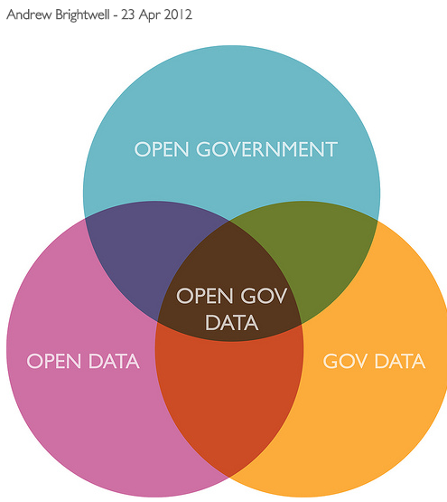
Outline
Kenya Open Data Portal
Site Stats
Where we Now?
Where are we headed?
Ministries
The Portal
Finding Data
Search, and Data Catalog
Manipulating Data : Tools
Requesting for Data
The Process
How you can help
Interaction
Open Government Data : Venn diagram by Justgrimes

Slide 32
Site Statistics – Where are we Now?
Views Loaded per Month
65,000 – 80,000
-> 390 Datasets
-> 500 Datasets
Over 190,000 Dataset Downloads.

Slide 33
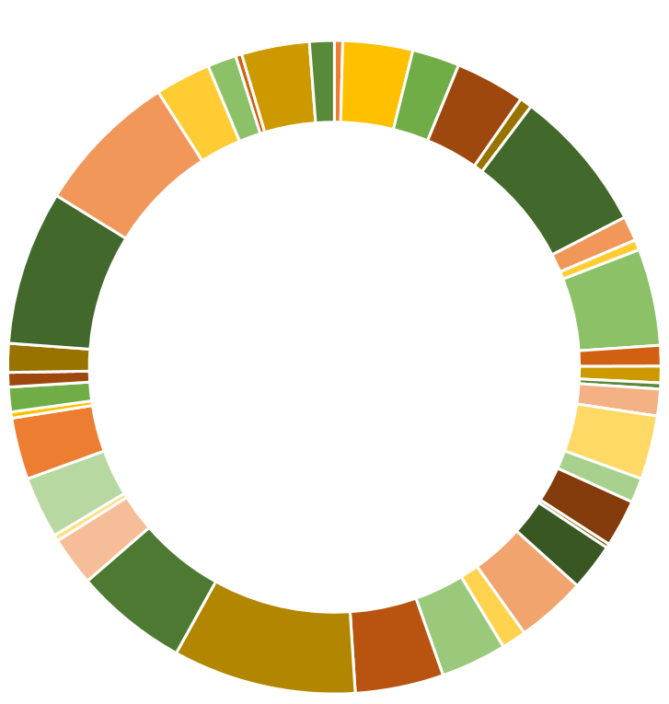
Site Statistics – Where are we Going?
Supply Side Open Data Survey
Open Data Fellows Program
Open Data Portal V2.0 = Better User Experience
Build Direct Relationships with Ministries and State Departments
NATIONAL GOVERNMENT
COUNTY GOVERNMENT

Slide 34
The Portal: Ministries / Agencies
Opendata.go.ke
DEMO:
Finding Data
Search
Data Catalog
Manipulating Data : Tools
Requesting for Data
The Process
How you can help
Interaction
Education Data
Health Data
Financial Data

Slide 35
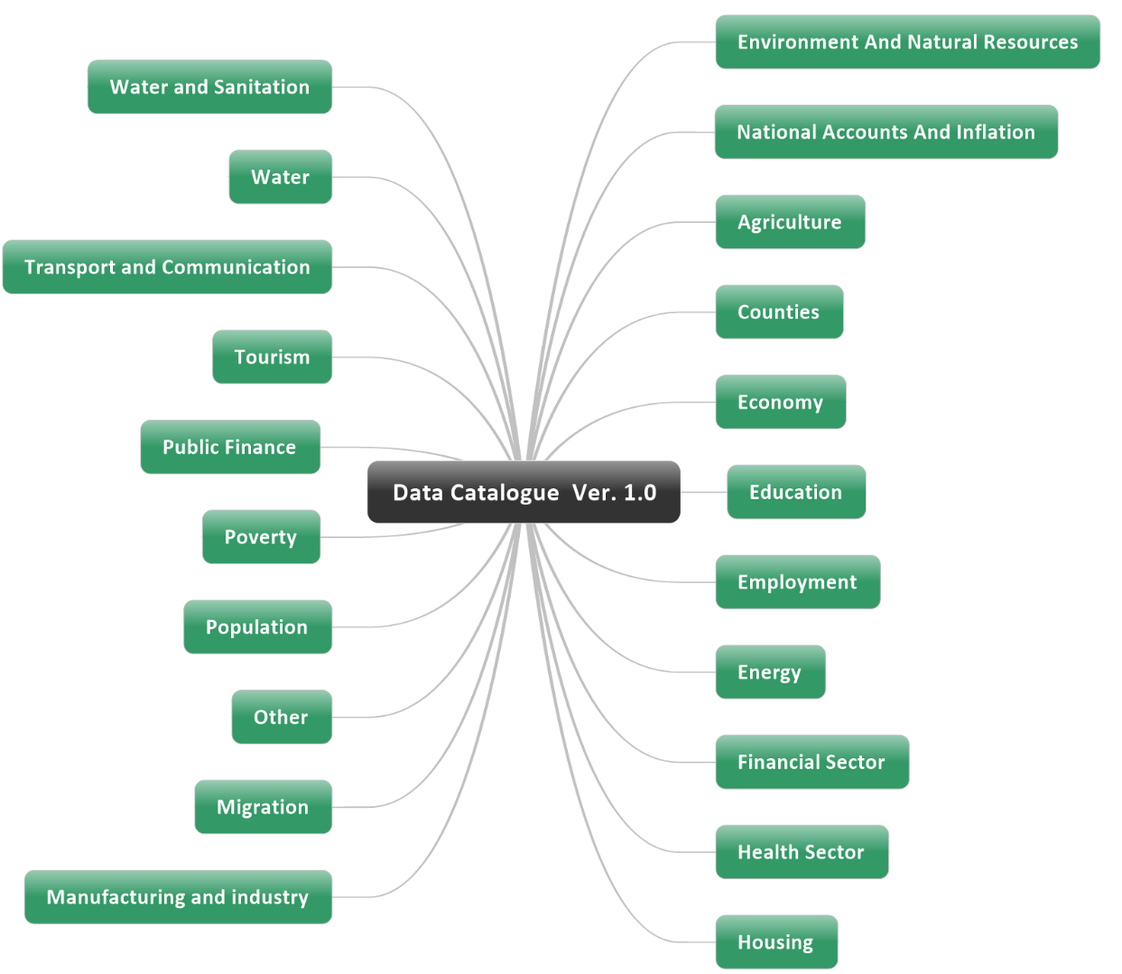
The Portal - Finding Data
Opendata.go.ke
Catalog Categories
Original Categories Ver 1.0 20 Interest topics

Slide 36
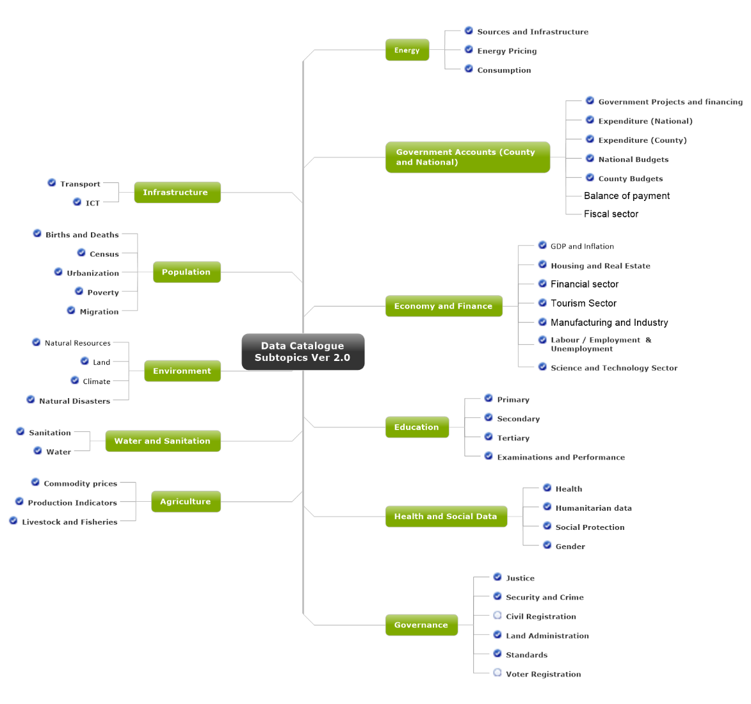
The Portal - Finding Data
Opendata.go.ke
Catalog Categories
Revamped Categories Ver 2.0 44 Interest topics
Only 11 Top Tier Categories

Slide 37
The Portal Tools.
Opendata.go.ke
DEMO:
Finding Data
Search
Data Catalog
Manipulating Data : Tools
Map Support
Chart Support
Requesting for Data
The Process
How you can help
Interaction

Slide 38
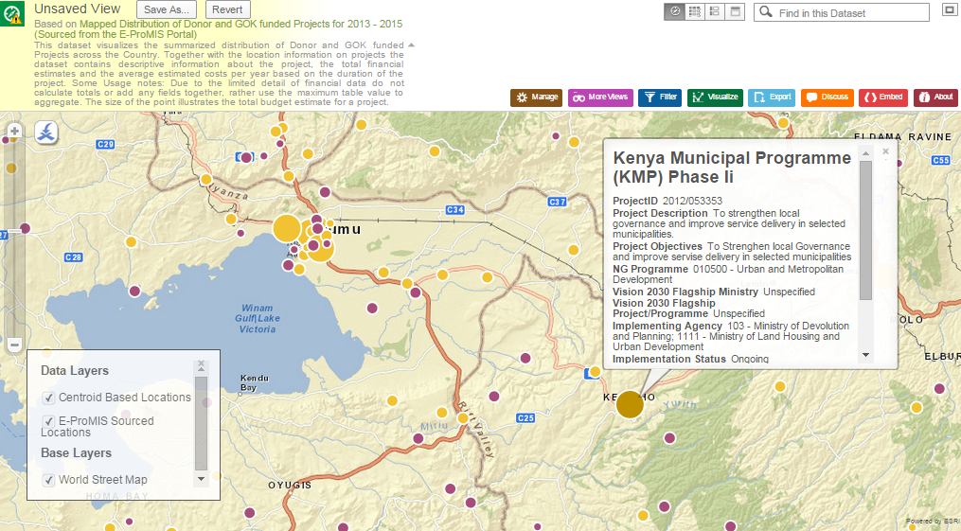
The Portal Tools: Map Support.
Opendata.go.ke

Slide 39
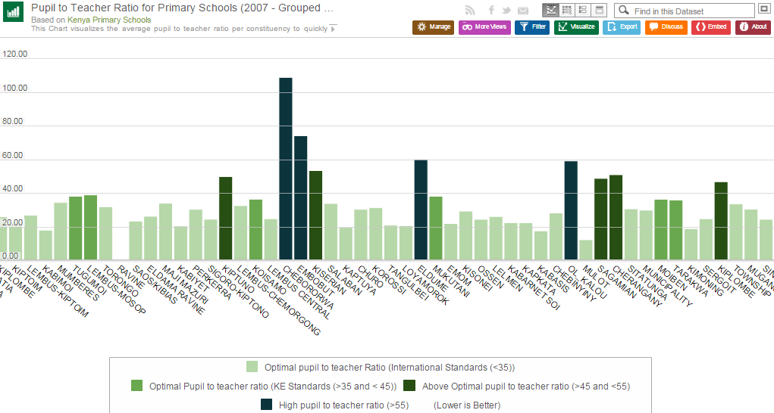
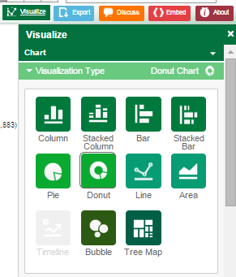
The Portal Tools: Chart Support.
Opendata.go.ke

Slide 40
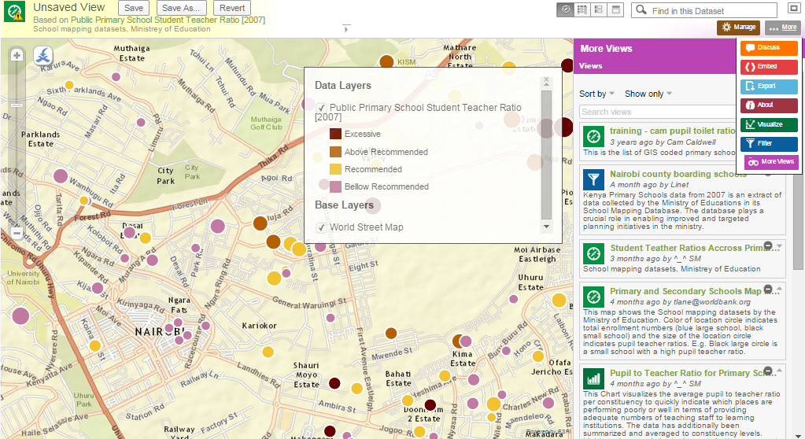
The Portal Tools: User Views
Opendata.go.ke

Slide 41
The Portal Tools.
Opendata.go.ke
DEMO:
Finding Data
Search
Data Catalog
Manipulating Data : Tools
Map Support
Chart Support
Requesting for Data
The Process
How you can help
Interaction

Slide 42
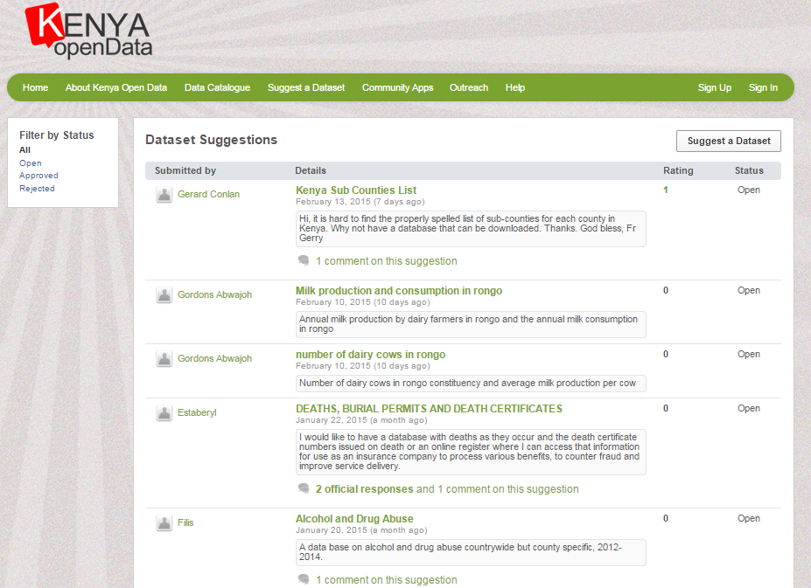
The Portal Tools: User Views
Opendata.go.ke
http://www.opendata.go.ke/nominate
How Can you help?
Ask For data

Slide 43
The Portal: Data Requests
Opendata.go.ke
DEMO:
Finding Data
Search
Data Catalog
Manipulating Data : Tools
Map Support
Chart Support
Requesting for Data
The Process
How you can help
Interaction

Slide 44
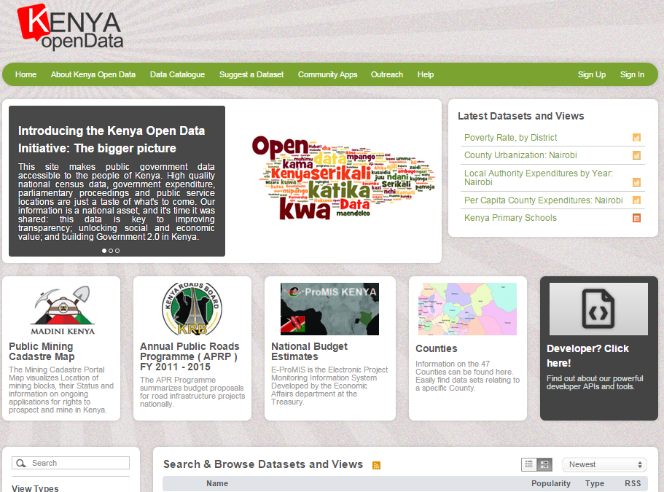
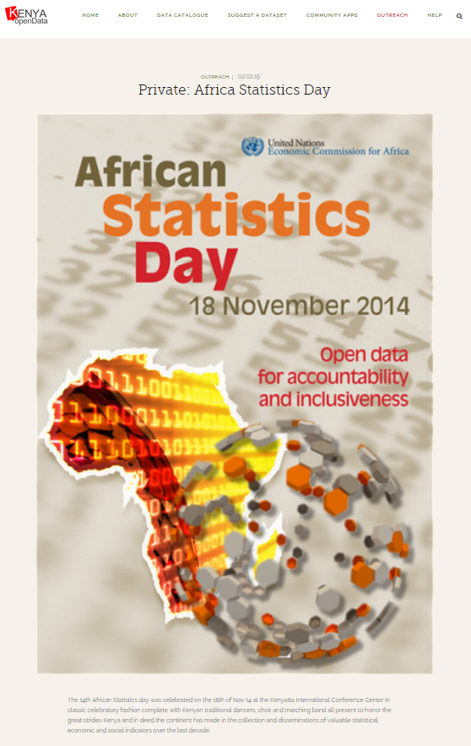
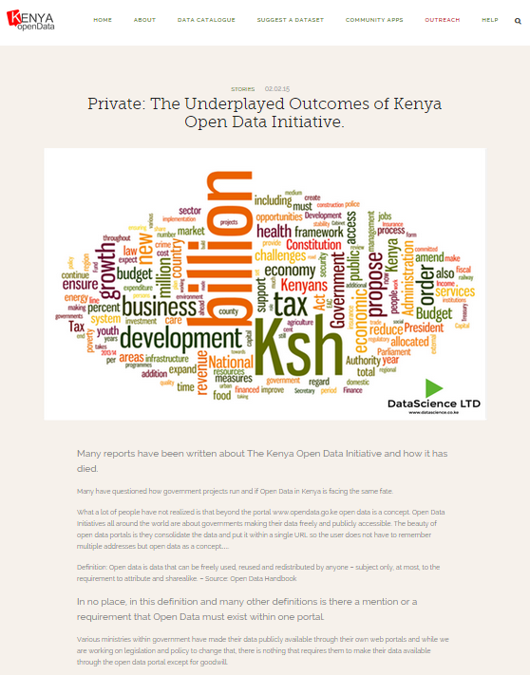
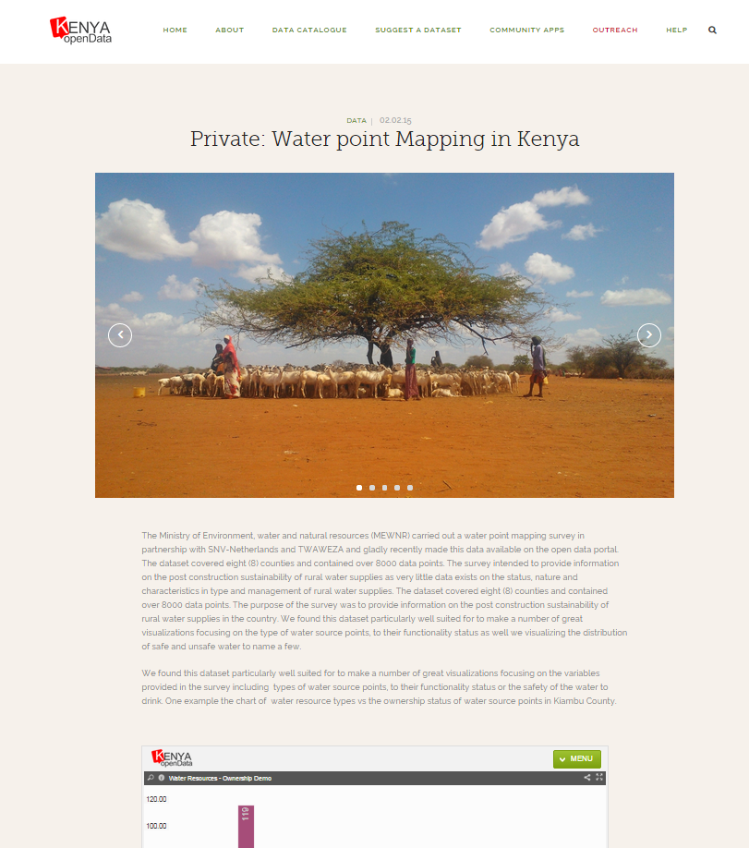
Interact With KODI
Tell Us How You use Open Data.
Stay informed
Join the Mailing list
Follow us on Twitter
Tell us about data you’ve collected with Government that should be open.
Feedback

Slide 45
Notable sources of other government data
Health, disaster and agriculture

Slide 46
Health Data
ehealth.or.ke {master facility list- location, contact, hours and type}
hiskenya.org {health indicators }
Desinventar.net { natural disaster-floods, thunderstorms, forest fires}
Data.hdx.rwlabs.org, kilimo.go.ke, centralbank.go.ke, knbs.or.ke, nacc.or.ke
Disaster Data
Others Data

Slide 47
Organizations that use kenya data
Businesses, Apps and Institutions

Slide 48
Zanaafrica.org
Type of Organization: Non Governmental Organization
Data used : School data (location, population and contact)
Developed an app
Outcome: Distribution of sanitary towels to students.

Slide 49
Zanaafrica.org
Type of Organization: Non Governmental Organization
Data used : School data (location, population and contact)
Developed an app
Outcome: Distribution of sanitary towels to students.

Slide 50
Data.hdx.rwlabs.org
Type of Organization: Un Agency
Data used : School data, Kenya Counties’ HIV Profile, Primary School
Developed visuals
Outcome: Marriage of Kenyan data with those from other institutions.

Slide 51
DataScience.co.ke
Type of Organization: Business Organization
Data used : School data, Kenya Counties’ HIV Profile, Primary School, shape files, Economic survey
Developed solutions
Outcome: made some good money

Slide 52
MedAfrica.org
Type of Organization: Business Organisation
Data used : Health Data
Developed app
Outcome: made some good money

Slide 53
Engagements with academia
Students and Staff

Slide 54
The Open Data Club
Periodic training on data analysis and visualizations.
Source for speakers/ Presenters Open Data Events.
Organise national and sometimes regional open data events. (Data hackathons)
Assist members to get the datasets they can use in their academic papers.

Slide 55
Guest Blog Posts
Expert opinions about datasets on the portal.
Twitter debates about data and posts.

Slide 56
challenges

Slide 57
It’s not a smooth sail
Agencies reluctant to release data
Lack of uniformity in data collection, analysis and dissemination
Some data is considered sensitive e.g civil registration data
Lack of a data policy making implementation a headache

Slide 58
Where do we go from here?

Slide 59
Way Forward
Collaborations with academia in identifying their data needs
Draft a data policy
Publish data collection, cleaning, analysis and publishing guidelines
Support the information act.

Slide 60
Photo Credits
Slide 2 (www.pixabay.com)
Slide 3 (www.mhealthafrica.com)
Slide 4 (www.cp-africa.com)
Slide 5 (www.no-straight-lines.com)
Slide 6 (www.pixabay.com)
Slide 7 (www.venturegalleries.com)
Slide 8 (www.flickr.com)
Slide 9 (www.livingurbanism.wordpress.com)
Slide 10 (www.archive.uni.edu)
Slide 20 (www.twitter.com/hadleywhicham)
slide 21 (www.github.com)
Slide 22 (www.realpython.com)
Slide 23 (www.diassouza.ninja)
Slide 30 (www.clipshrine.com)

Slide 61
Thank you

